Slide 1



Prince George’s County Public Schools
Value of Test Preparation
Justina Molokwu, Tyra Rodgers & Zohra Noor
Notes:
In this presentation we will be discussing the value of test preparation with the Prince George’s County Public Schools Department.

Slide 2

PRINCE GEORGE’S COUNTY PUBLIC SCHOOLS BACKGROUND
Prince George's County Public Schools (PGCPS), one of the nation's 25 largest school districts.
The school system serves a diverse student population from urban, suburban and rural communities located in the Washington, DC suburbs.
PGCPS is nationally recognized for innovative programs that provide students with unique learning opportunities.
Test Preparation: OPTIONAL PSAT test preparation
Notes:
Prince George’s County is recognized as one of the nation’s largest school districts. Being such a large district, it is no surprise that the students in this district are very diverse in background, ethnicity, SES, and academic skill sets.
Prince George’s County is also recognized for its innovative academic programs which provide students with unique learning opportunities. Although the county is recognized for innovative programs, one program that they could improve upon is their SAT and pre SAT preparation. Currently, the county offers test preparation courses on an optional and not mandatory basis. The current SAT score average for PG County is 1030, while the national average is 1051. Count the non-mandatory psat preparation courses be playing a role in this disparity?

Slide 3
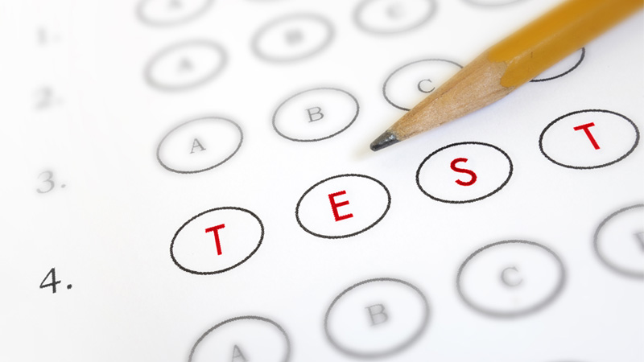

QUESTION
Do students that receive test preparation score higher (in writing, math and reading) than students that don’t receive test preparation?
Notes:
The question we are here to investigate today is whether or not test preparation makes a significant difference in student score outcomes. Specifically, we want to know if students receiving test preparation score higher in writing math and reading scores than students who report no test preparation.

Slide 4

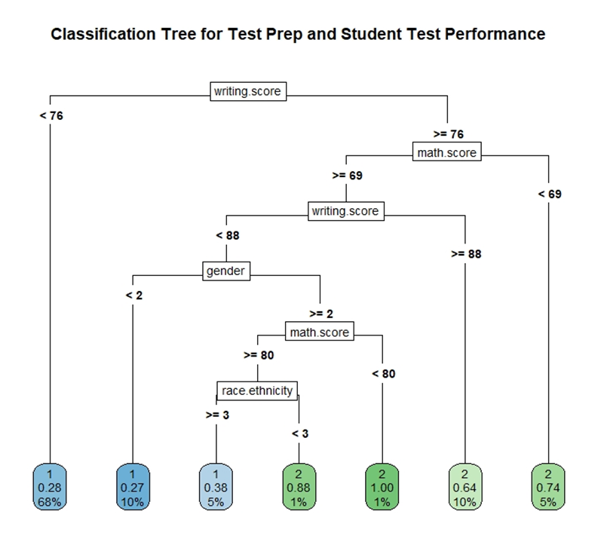
THE VALUE OF TEST PREPARATION
TEST PREP’S RELATIONSHIP TO WRITING, MATH & READING TESTING SCORES
68% of students that scored below 76% on writing test were students that did not complete a test preparation course
Variables: Gender, Race/Ethnicity, Parental Level of Education, Lunch, Test Preparation Course, Math Score, Reading Score and Writing Score
Found that the most important factor was writing scores (39% of variable importance)
Two models were completed:
KNN classification of test preparation versus no test preparation: these variables only gave accuracy of 69.5%
Decision Tree classification: these variables gave accuracy of 71.8%
Notes:
1=none
2=completed test prep
As you can see in the decision tree to the right, looking at the bottom nodes, 15% of students that received no test prep vesus 2% of students that received test prep scored lower than 69% in writing as well as lower than 80% in math.

Slide 5
RECOMMENDATIONS
PROVIDE FREE & MANDATORY TEST PREPARATION COURSES!
Funding preparation academies/courses to be included in the county curriculum
After implementing free and mandatory test preparation courses, compare pre and post implementation scores
Notes:
Since writing was the most important factor and there was a noticeable difference in the scores for writing test between students that received no test prep versus completed test prep, we recommend PGCPS focus on funding test prep courses to be included in county curriculum and especially focusing on writing test preparation.
-have students who did really well on the PSAT’s use community service hours to tutor their classmates if possible
-Introduce a weekend PSAT academy on school grounds to give students more opportunity to train for the exams

Slide 6
THANK YOU
ANY QUESTIONS?

